Slide 1
​
"Ensuring that each child reaches their potential and develops an enthusiasm for lifelong learning."

Slide 2
We would like to extend a warm welcome to you and your family, thank you for joining us for our Year 1 parent meeting. Today we aim to share some key messages and an overview of the exciting adventure that your child will embark upon during their time in Year 1.
At St Marys we want you to feel involved in your child’s learning and to be confident to share any worries, concerns or celebratory news with us.

Slide 3
The School Day
Children arrive from 8:40 when the playground gates open.
Gates will close at 08:50; anyone who arrives after this time will be marked as late.
Playtime is at 10:30 to 10:45. Lunchtime is 12:00 to 13:00.
Home time is at 15:15 – children need to be collected from their class room which can be accessed via the KS1 playground.
By 15:25 children will be taken to the office to wait in the reception area for pickup, except on a Wednesday, where they will be taken there by 15:20.

Slide 4
School Uniform
We try to keep our school uniform rules simple and make sure that the items are easily accessible and affordable.
The school uniform is:
Blue school jumper/cardigan
Grey/black trousers/shorts/skirt
Black shoes/trainers
Light blue/white t-shirt with collar and blue checked cotton school dresses are permitted in warmer weather.
No make-up / nails, and no jewellery other than discreet ear studs and / or for religious purposes.

Slide 5
PE
Our PE days are:
Monday and Thursday
Please ensure that children come to school wearing their P.E. kit on these days. The PE kit is:
Black or navy shorts
Black or navy tracksuit bottoms/leggings
White/light blue round neck t-shirt
Trainers
Black or navy jacket/jumper/hoodie
Please remember that on PE days long hair should be tied back at all times and jewellery should be removed.
If your child is not going to participate in PE due to medical reasons, then a signed doctor’s note will be required.

Slide 6
Homework
Homework will be sent out on a Friday and will need to be returned the following Friday.
Homework will be a combination of handwriting, spelling and maths based on the learning during the week.
Children should also be reading at home every day!

Slide 7
Reading and Phonics
Every week your child will bring home two books, a reading book and a phonics book.
Please ensure that your child reads at home every day. Please record any comments in their reading diary.
Books will be changed every week on a Friday.
Your child will also have lots of opportunities to read in class during our shared and guided reading sessons.

Slide 8
When Reading With Your Child
Encourage them to use their phonic knowledge to read new words.
Talk to your child about what happens in the book.
Ask children to predict what might happen in the story.
Discuss emotions and feelings.
Describe the characters and their motives.
Relate the book to real life.
Look out for new vocabulary

Slide 9
Phonics
Phonics plays a big part of the Year 1 curriculum.
Phonics will be taught everyday and will be used through out all areas of the curriculum.
We will be using the ALS Phonics scheme.
In the summer term all children in Year 1 will have to complete the Year 1 Phonics Screening Check.

Slide 10
High Frequency Words

Slide 11
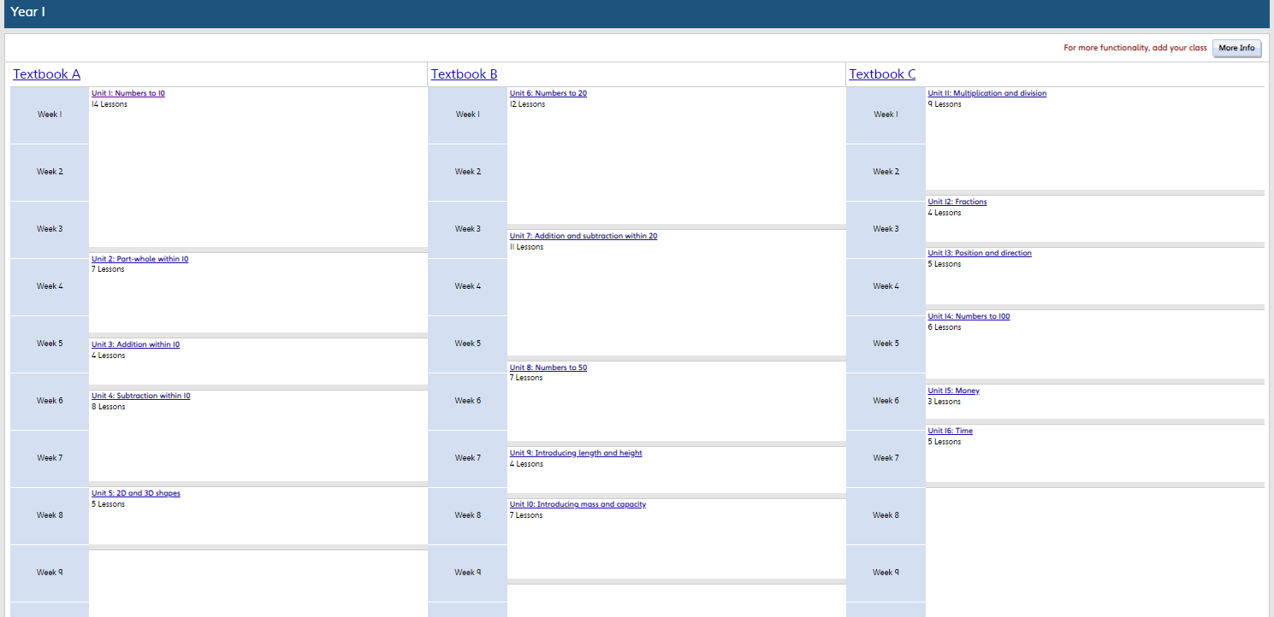
Mathematics
We follow Power Math which is in conjunction with White Rose

Slide 12
Our Curriculum – Knowledge Organisers

Slide 13
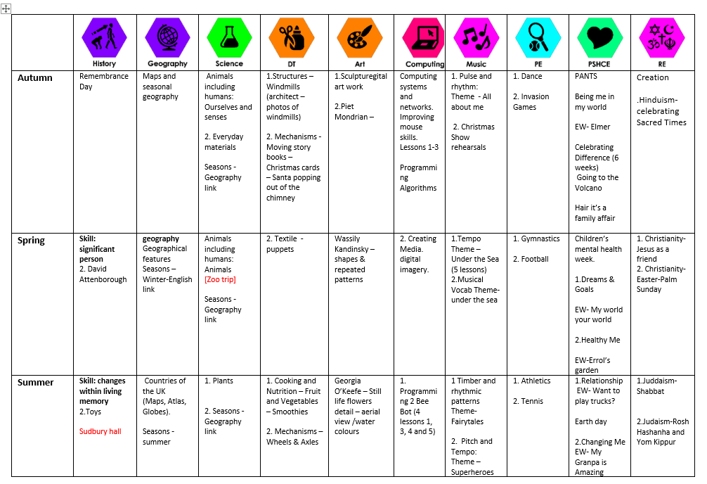
Our Curriculum – Long Term Plan

Slide 14
Trips and Visits
This year we are hoping to arrange the following trips and visits for our Year 1 pupils.
Autumn Term 2 - Visit to the Curve Theatre
Spring Term – Visit to Twycross Zoo
Summer Term – Visit to Sudbury Hall Toy Museum
Visit to a Synagogue
* all trips are subject to availability and may change

Slide 15
Keeping Children Safe
If you have any concerns or worries about a pupil at St Mary’s Fields Academy, please come and speak with a member of our safeguarding team or complete a form at the school office.
Mrs. H Knott
Mrs. L Haycock
Mrs. J Linnell
Mrs. C Alba
Ms. P Hulait
Mr. J Clark

Slide 16
Any Questions?
Thank you for joining us for our Year 1 meeting.
If you have any questions please ask.

