Slide 1
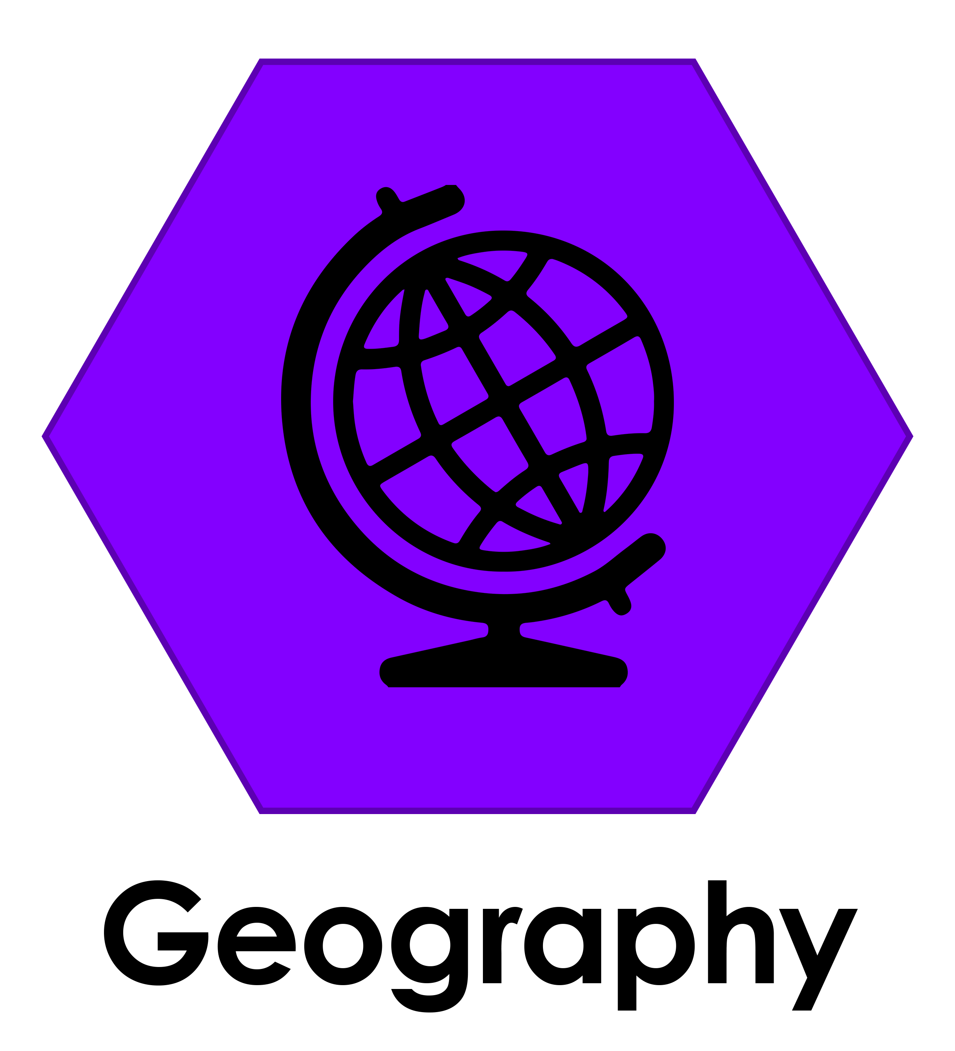
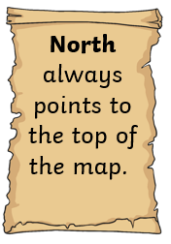
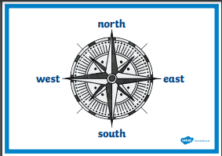
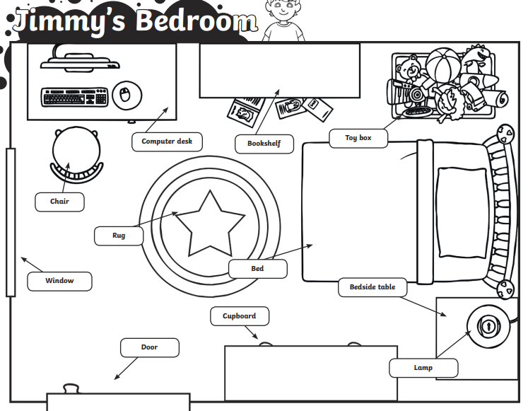
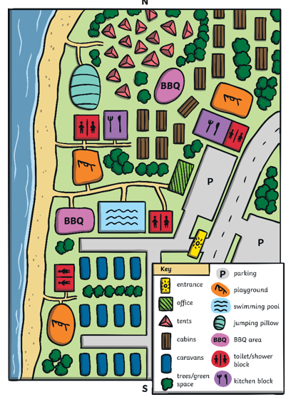
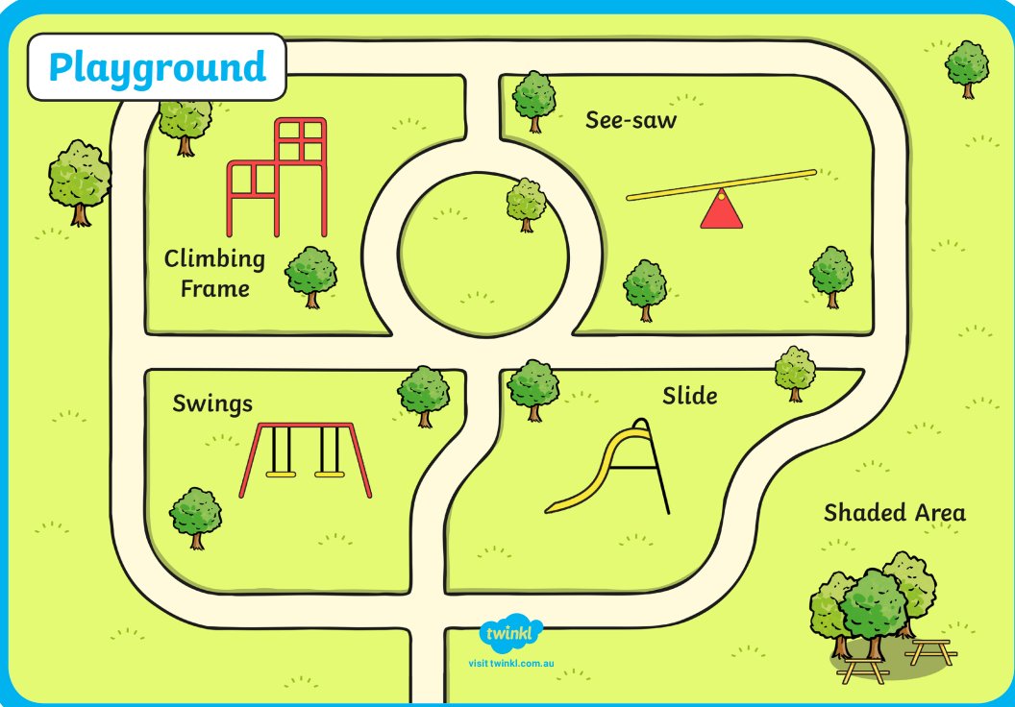
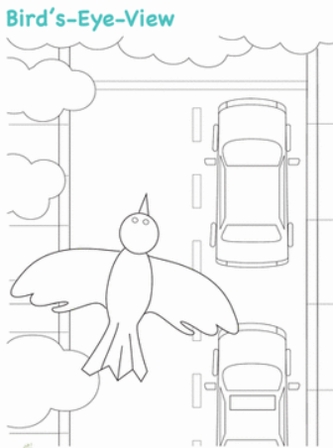
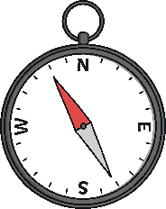
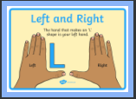
Year 1 – Autumn 1 Knowledge Orga niser Why do we use maps?
Geography is learning about Earth’s water, land and living things.
Compass
Maps show us where things are and can help us to get to them.
We are word collectors:
features | Things you can see on a map
 | Left, right, up, down, near, far, north, south, west, east
distance | How near or far something is
compass | Points to the direction in which you are going: north, south, west, east
map symbols | Pictures that show us where things or places are on a map
Types of maps
Key Skill!!!!
Map symbols
The view a bird would have if it were flying over an area

