Slide 1
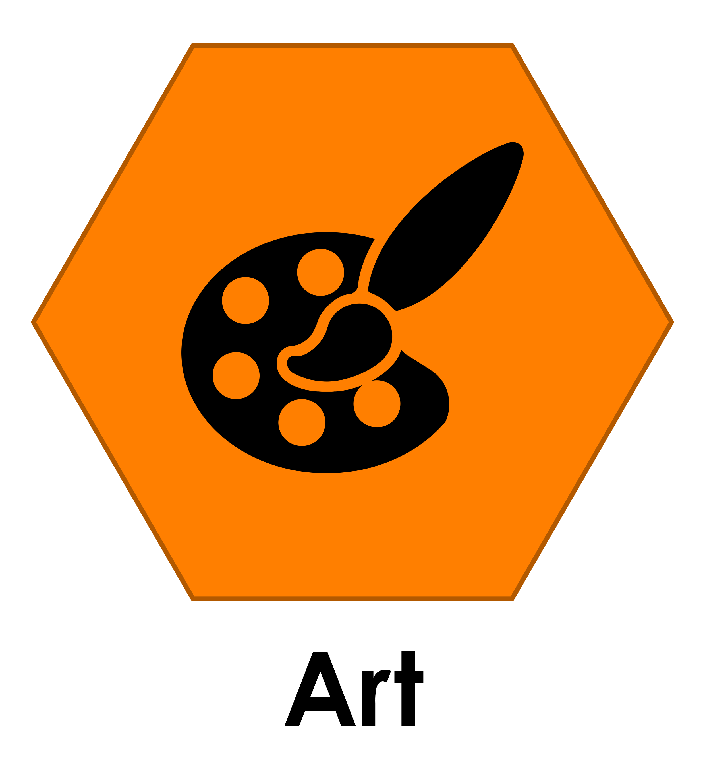
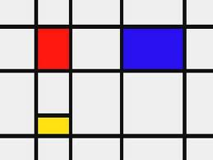
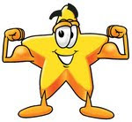
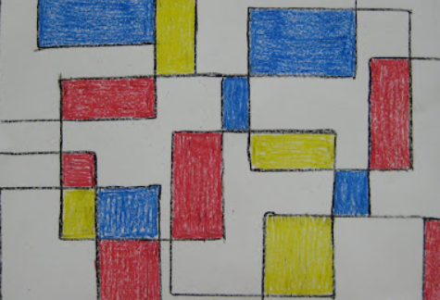
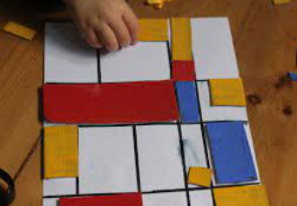
Year 1 – Autumn 1 – How will Piet Mondrian inspire your paintings? Art Knowledge Organiser
National Curriculum information:
Character Muscles
Creativity
How can my family help me? Questions they can ask me and knowledge they can quiz me on.
What do you know about Piet Mondrian? Can you remember what colours he used in lots of his paintings? Can you make a Mondrian inspired painting or Lego model at home?
Links to other learning … This art unit links to what we learn in maths about 2D shapes and what we learned about colour in Foundation 2. It will build the foundation for our learning about secondary and warm and cool colours later in the year.
Further Learning I can do at home Explore the Tate Kids website: https://www.tate.org.uk/kids/explore/who-is/who-piet-mondrian Spot primary colours on a walk, in shops or at home. Practice drawing lines with a ruler. Talk about any type of art and what you like or don’t like!
-We will use a range of materials creatively to design and make products.
-We will use painting to develop and share our ideas, experiences & imagination.
-We will develop a wide range of art & design techniques in using colour, line, shape, form & space.
-We will learn about the work of a range of artists, craft makers and designers, describing the differences and similarities between different practices and disciplines, and making links to our own work
We will be artists by:
-Learning new vocabulary and begin to use it to show our knowledge & understanding.
-Using a range of materials to create a collage in the style of Piet Mondrian.
-Create my own “Mondrian” painting and experiment with thick and thin lines.
How will my learning be assessed?
There will be photographs in the class floor book. Children will talk about Mondrian’s paintings, their own work and also the work of other children.

Slide 2
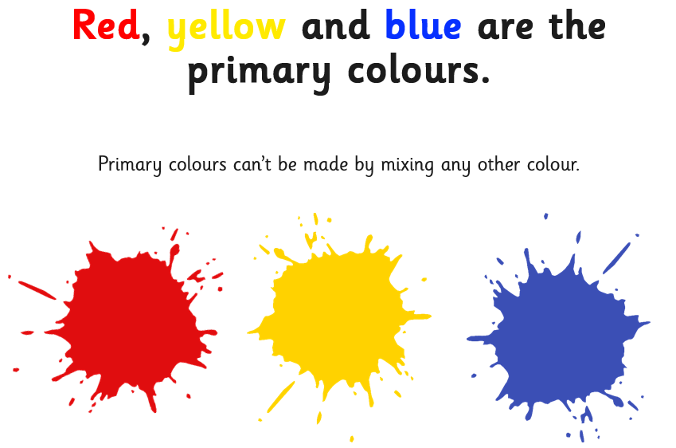
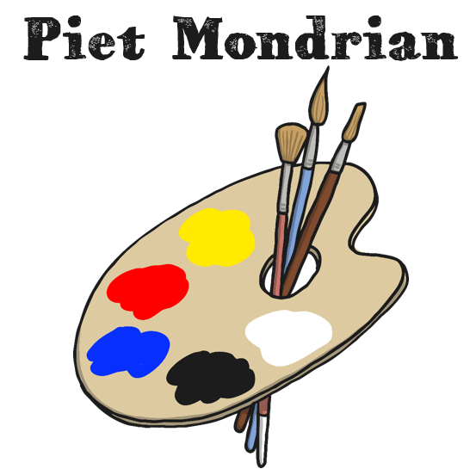
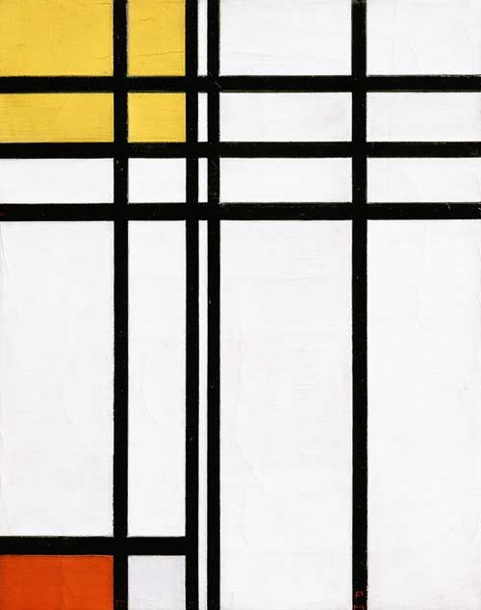
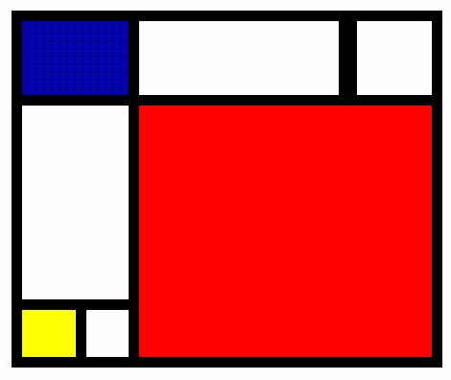
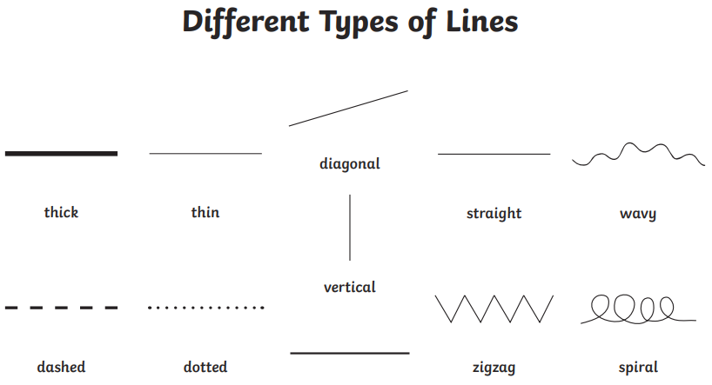
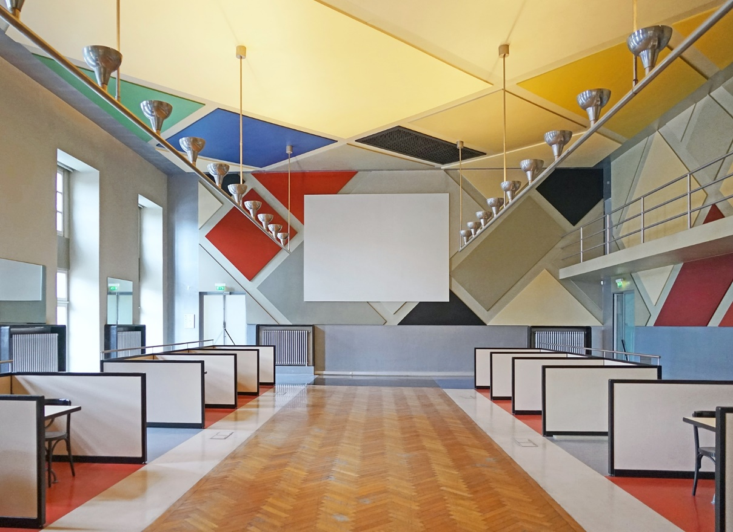
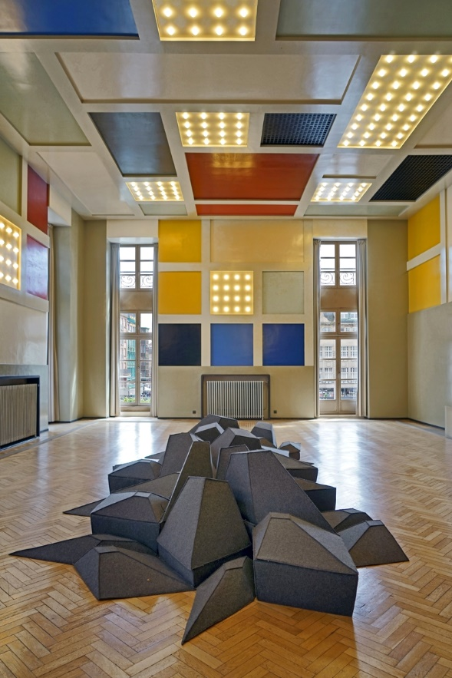
The Knowledge – The things I need to know and remember
Key Knowledge
We are word collectors
Here are some words we will use when we talk about Mondrian’s paintings and do our own work:
Words to remember from last year:
primary colours – red, blue, yellow, white, black
shape ,rectangle, square
New words for Year 1
outline, edge, shape, space, straight, line, thick, thin, art, artist, inspire, abstract
Mondrian was interested in abstract art. Abstract art doesn’t show pictures of things but uses colours, lines and shapes to express how the artist is feeling.
Mondrian liked to paint using the primary colours with black lines and white spaces.
Self Portrait (c1900)
by Piet Mondrian
Have you ever seen anything inspired by Mondrian’s work?

