Slide 1
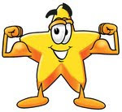
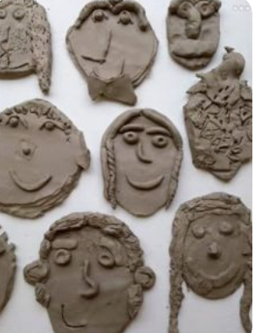
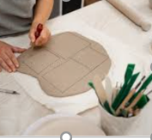
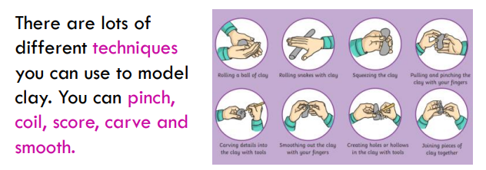
Year 1 – Autumn 1 – Clay Sculptures - Art Knowledge Organiser
National Curriculum information:
Character Muscles
Creativity
How can my family help me? Questions they can ask me and knowledge they can quiz me on.
Do you know any famous artists who create clay sculptures? Can you remember what techniques artists use when working with clay? Can you talk about different things made form clay at home?
Links to other learning … This art unit links to what we learning in science linking to the 5 senses. Also in our computing topic we have been looking at how to draw computerised facial images.
Further Learning I can do at home Explore what is clay website and how to use it: https://www.youtube.com/watch?app=desktop&v=2N7bhkOyuJg Use modelling materials such as Play Doh to make their own models at home. Look at photographs and discuss different facial features. Talk about any type of art and what you like or don’t like!
-We will use a range of materials creatively to design and make products.
-We will use clay to develop and sculpture to design and make products
- We will develop a range of design techniques using line, shape, form and space
--We will learn about the work of a range of artists, craft makers and designers, describing the differences and similarities between different practices and disciplines, and making links to our own work
We will be artists by:
-Learning new vocabulary and begin to use it to show our knowledge & understanding.
-Using a range of materials to sculpt, mould and carve in clay create a clay sculpture.
-Create my own clay sculpture
How will my learning be assessed?
There will be photographs in the class floor book. Children will talk about their own work and also the work of other children.

