Slide 1

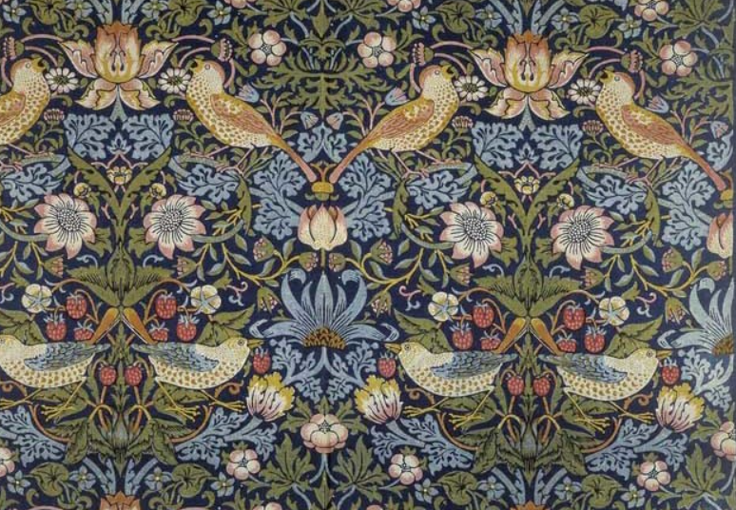
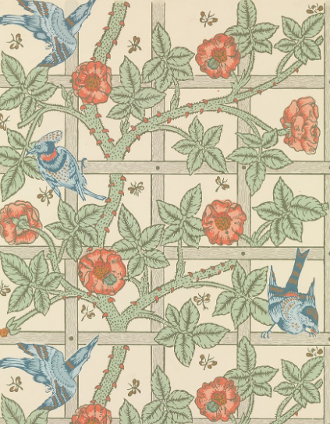
Year 2 – Summer The Knowledge William Morris: artist, poet, manufacturer
We are word collectors:
textiles | Fabrics or cloths used for things like curtains and clothes
designer | a person who comes up with something new
pattern | A repeated design, often used on wallpaper or fabric
Arts and Crafts | A movement that wanted to bring back hand-made crafts and make art beautiful and useful
William Morris
1834-1896
Morris was an inspirational figure in the Arts and Craft Movement. He used his art work and designs to
create stained glass windows, tapestries, fabrics and wall papers.
Strawberry Thief
(tapestry)
William Morris’ Style
Natural Patterns: Morris often drew from nature. Look at his work to find leaves, vines, and flowers.
Detailed and Repeated: Morris liked to repeat his patterns to cover large areas like walls or curtains.
Rich Colours: He used lots of deep greens, blues, and reds.
What did William Morris believe?
He believed that things should be well-made and beautiful.
He thought people should make things by hand instead of using machines.
Morris was part of a movement called the Arts and Crafts Movement, which wanted to make sure that art and craft were combined and valued equally.
Trellis
(wallpaper design)

