Slide 1
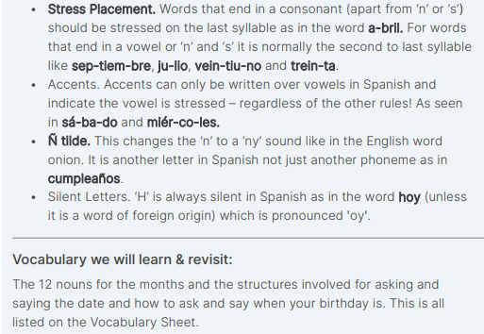
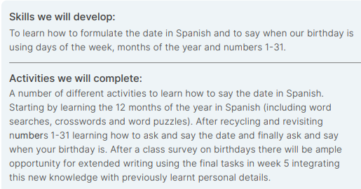
Year 5 – Autumn 2 – The Date – Spanish – Knowledge Organiser

Slide 2
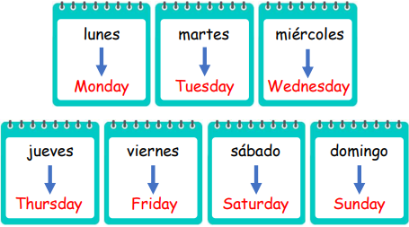
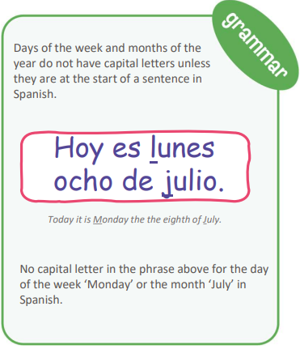
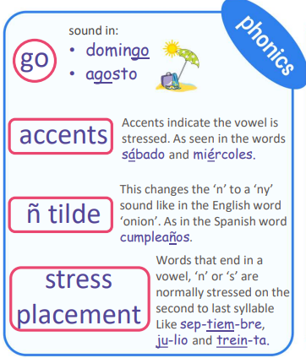
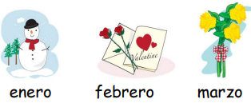
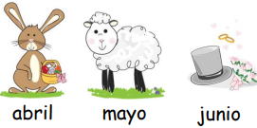
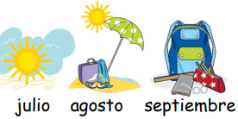
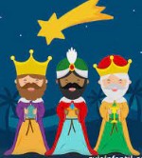
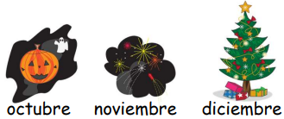
Year 5 – Autumn 2 – The Date – Spanish – Knowledge Organiser
THE 7 DAYS OF THE WEEK
THE 12 MONTHS OF THE YEAR
NUMBERS 11 - 31
Use preposition ‘de’ before months and years
INTERCULTURAL KNOWLEDGE:
Christmas:
Religious celebrations and
traditions in Spanish-speaking countries.

