Slide 1
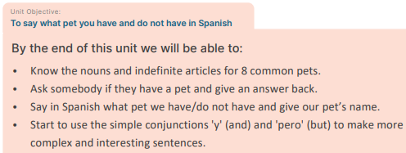
Year 5 – Autumn 1 – Do you have a pet? – Spanish – Knowledge Organiser

Slide 2
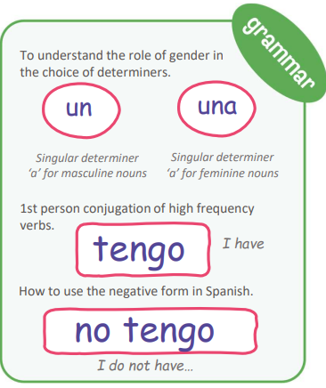
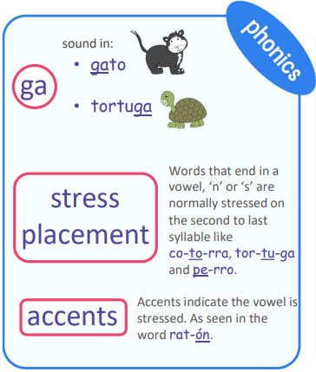
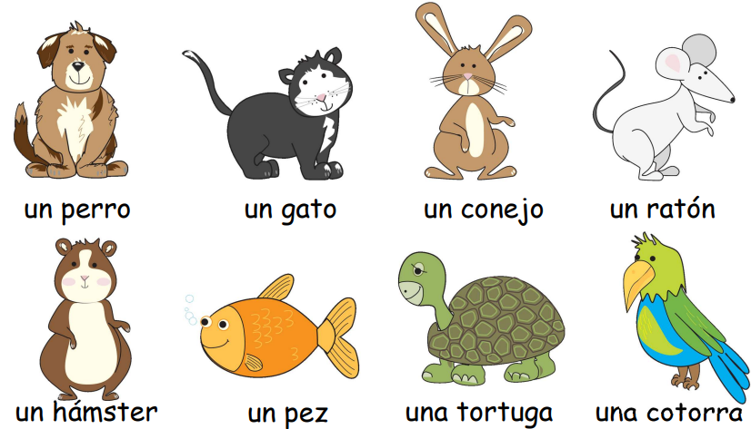
Year 5 – Autumn 1 – Do you have a pet? – Spanish – Knowledge Organiser
INTERCULTURAL KNOWLEDGE:
Languages Day:
Languages spoken and personal identity.

