Slide 1
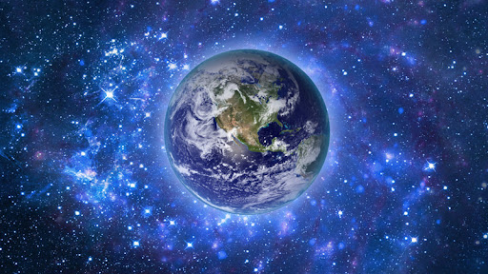
Year 5 Science – Earth and Space Knowledge, Skills and Progression Organiser
Autumn Term 1 2022-2023
Enquiry Question: What does our solar system look like?
Why this/why now?
While this unit represents a largely standalone topic, it does however link to learning from year 1 looking at the 4 seasons and describing weather. The unit has been placed here to link to the Natural Disasters topic in geography, as well as cross-curricular opportunities in reading, writing and Design and Technology.
How does this link to the National Curriculum?
Year 5 Programme of Study – Earth and Space
As well as using our working scientifically skills, we will be scientists by:
describe the movement of the Earth, and other planets, relative to the Sun in the solar system
• describe the movement of the Moon relative to the Earth
• describe the Sun, Earth and Moon as approximately spherical bodies
• use the idea of the Earth’s rotation to explain day and night and the apparent movement of the sun across the sky.
Are there any trips and/or links to Leicester?
Leicester Space Centre
How will this unit of work be assessed?
Through assessment for learning, work in books, observations of working scientifically
How will the learning journey be evidenced?
In books, through writing and photographs of practical investigations
Character Muscles
Problem-solving
Questioning
Curiosity
Things my family can ask me:
Why does the moon often appear to be different shapes?
How long does it take the earth to do 1 full rotation on its axis?
Links to other subjects
Geography – Natural Disasters
DT – Volcanoes
Reading - Natural disasters by Johanna Haney (STEM)

Slide 2
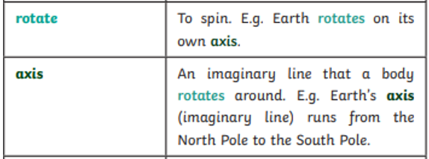
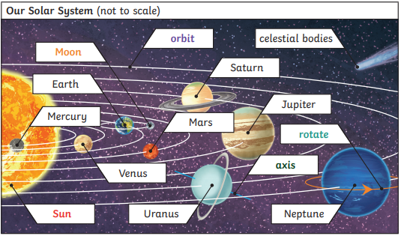
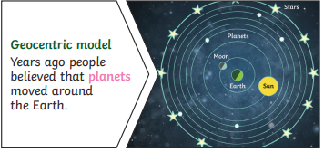
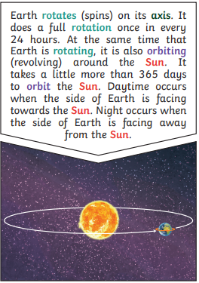
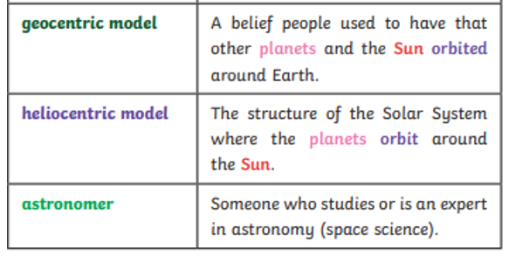
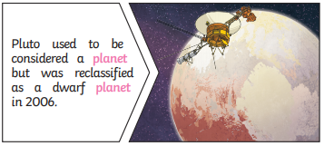
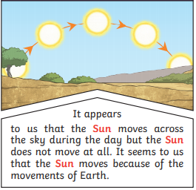
The Knowledge – The things I need to know and remember
Key Knowledge
Golden Words
Key Vocabulary
Further Research: BBC Bitesize
https://www.bbc.co.uk/bitesize/topics/zkbbkqt

