Slide 1
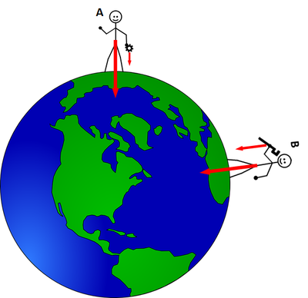
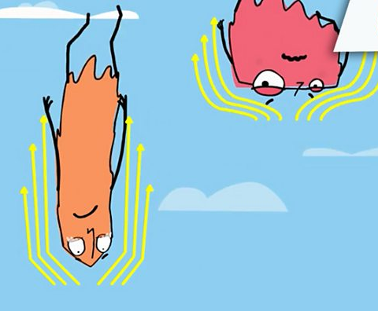
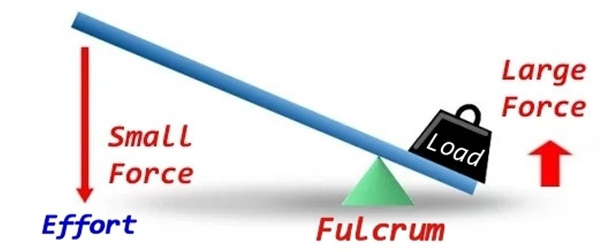
Year 5 – Autumn – What are forces? – Science – Knowledge Organiser
Key Vocabulary
Force | Strength or energy as an attribute of physical action or movement
Friction | The resistance that one surface or objects encounters when moving over another
Gravity | The force that attracts a body towards the centre of the Earth, or towards any other physical body having mass
Air resistance | Friction that occurs between air and another object
Water resistance | Friction that occurs between water and another object
Pulley | A wheel with a grooved rim around which a cord passes, which acts to change the direction of a force applied to the cord and is used to raise heavy weights
Lever | A rigid bar rested on a pivot, used to move a heavy or firmly fixed load with one end when pressure is applied to the other
Variables | An element, feature, or factor that is liable to vary or change
Control variable | A variable that is held constant or limited during research
Independent variable | A variable whose variation does not depend on that of another
Dependent variable | A variable whose value depends on that of another
Friction is a force that occurs when two or more objects move over one another. Depending on the properties of the objects, such as what material they are made of or what shape they are, the friction can be stronger or weaker.
Air resistance and water resistance are both examples of friction, caused when something moves through the particles that make up the air or water. This can make objects move slower or faster through the air or water, depending on their shape.
Gravity is a force that means that anything with mass is attracted to (pulled towards) anything else with mass.
Because the Earth is the biggest mass anywhere near us, everything that exists on it is being pulled towards the centre of it. This is why we don’t just float away into space!
A lever is a mechanism that allows the user to use a small amount of force on one end and have that become a much larger force at the other end.
This is because the downward force is being applied over a much bigger area, so on the other end all of that force is applied in a much smaller area, making it stronger.

