Slide 1
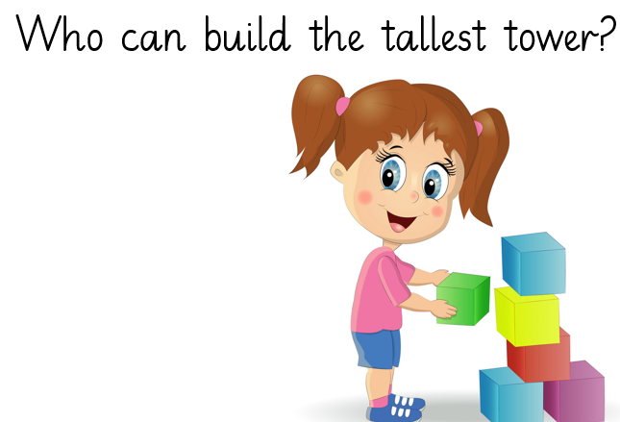
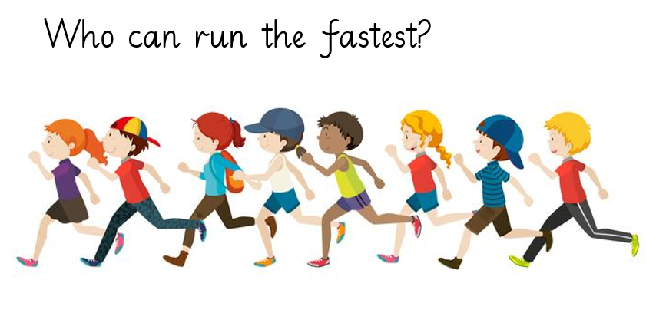
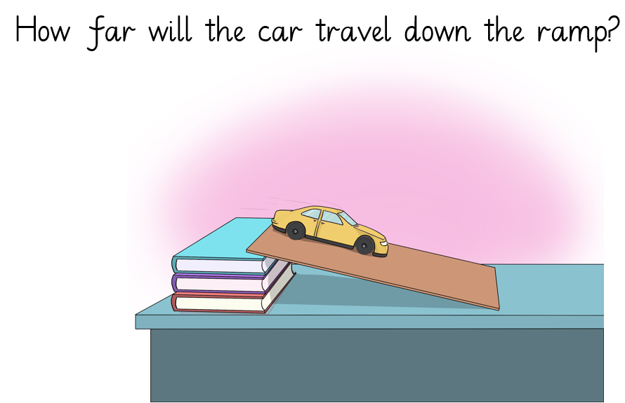
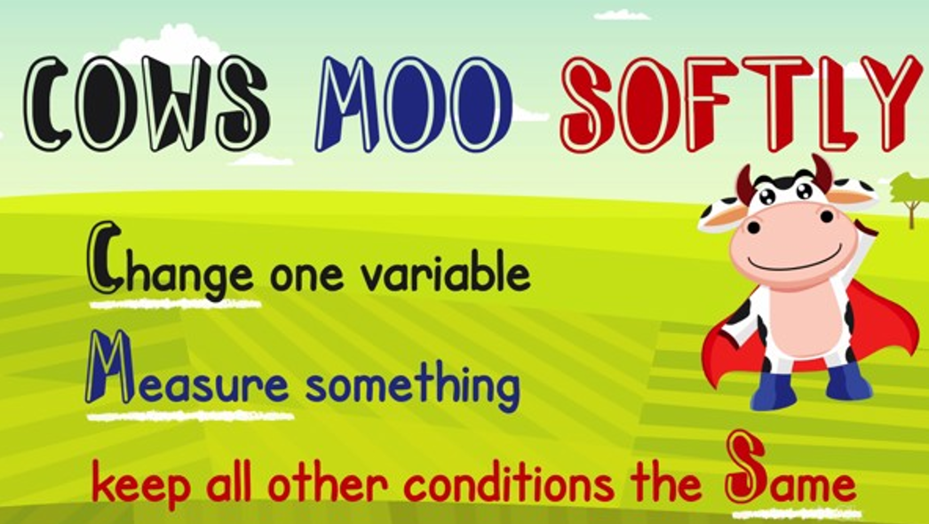
Year 2 Autumn 2- Working Scientifically
We are word collectors:
Fair test | A test where only one variable changes
variable | A factor that can change
change | To compare is to think about the similarities and differences of two different things.
Measure | To record a change.
observe | To look at closely
Fair testing
How will you make your test fair?
What is your prediction?
What equipment will you need?

