Slide 1
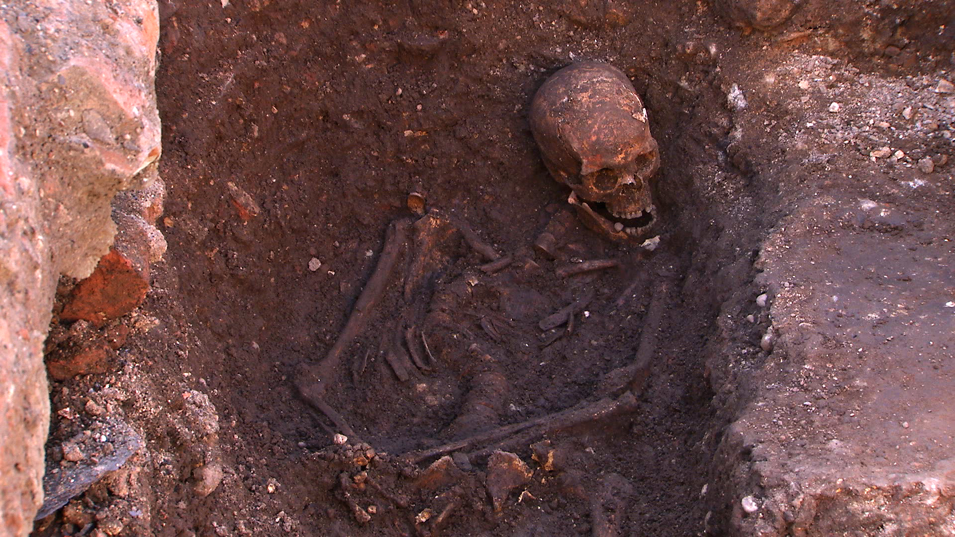
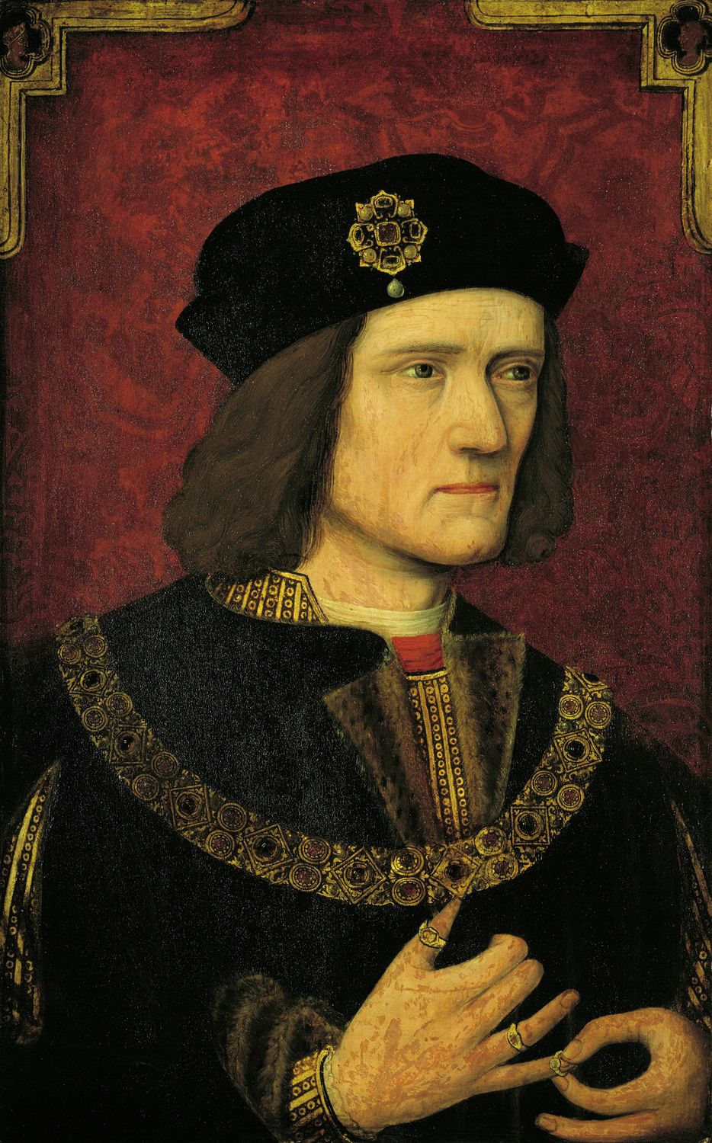
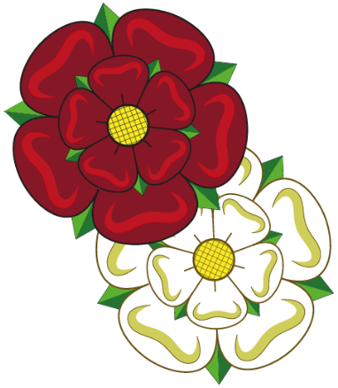
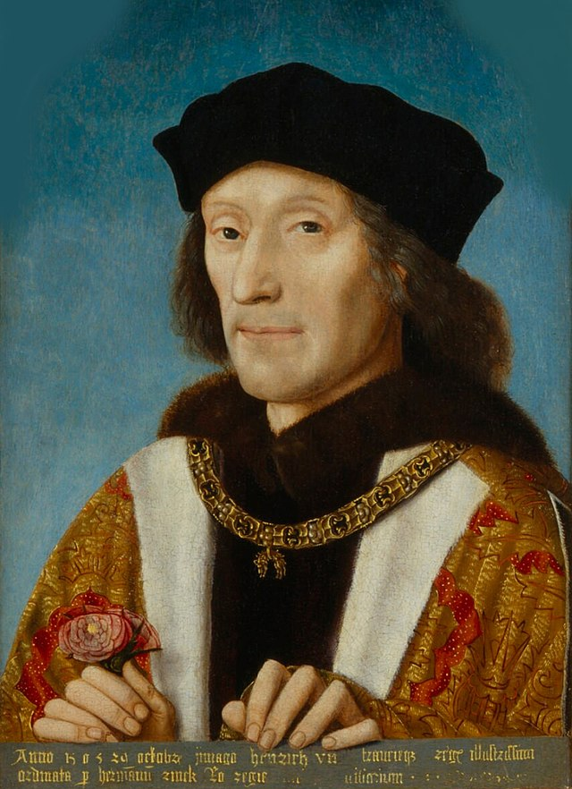
Year 5 – Autumn – Who was Richard III? – History – Knowledge Organiser
Key Vocabulary
Primary Source | Information and objects that come from the time being studied
Secondary Source | Interpretations of information and objects which are produced after the time being studied
Chronologically | The order in which the events happen
Heir | A person legally entitled to the property or rank of another on that person’s death.
Excavate | Remove earth carefully from (an area) in order to find buried remains.
Archaeologist | A person who studies human history and prehistory through the excavation of sites and the analysis of artefacts and other physical remains.
Civil War | A war between citizens of the same country.
Bias | Inclination or prejudice for or against one person or group, especially in a way considered to be unfair.
Analyse | Examine (something) methodically and in detail, typically in order to explain and interpret it.
Richard III is someone historians can sometimes have different opinions of.
The thing he is perhaps most infamous for is the supposed murder of his two nephews, as they had a better claim to the throne than he did. However, no proof has ever been found.
He is also very well known as the protagonist in Shakespeare’s play about his life (also called Richard III), where he is a villainous character.
In August 1485 King Richard III was killed at the Battle of Bosworth, brought back to Leicester and after a lying in state for a few days was buried by the Grey Friars, in their friary church.
In August 2012, 527 later, Leicester City Council, the University of Leicester, and the Richard III Society began an archaeological, a search underneath a car park in Leicester, to find King Richard III’s remains and the Grey Friars Church.
These roses represent the houses of Lancaster (Red) and York (White). When Richard III was defeated at the Battle of Bosworth, Henry Tudor united the two houses and created the Tudor Rose from them.
Henry VII was the last king of England to win the crown in battle. After the Battle of Bosworth, he married Elizabeth of York and united the houses into the new House of Tudor.

