Slide 1
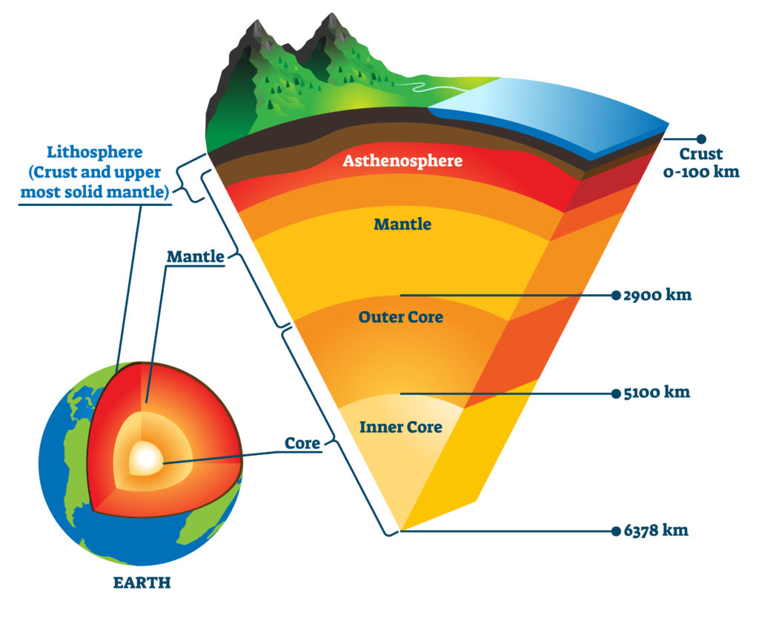
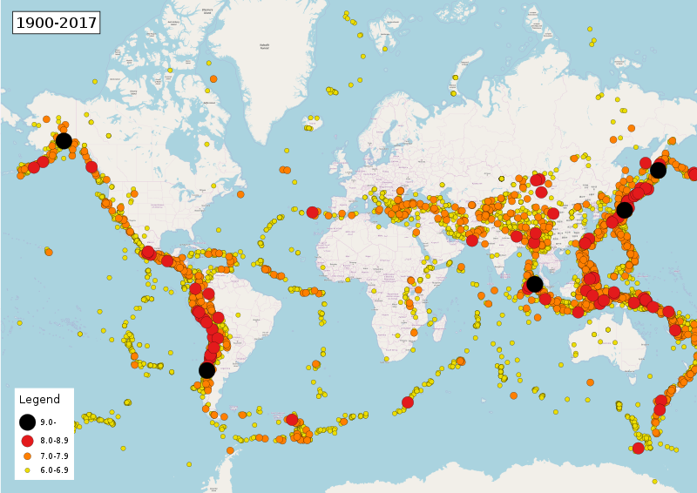
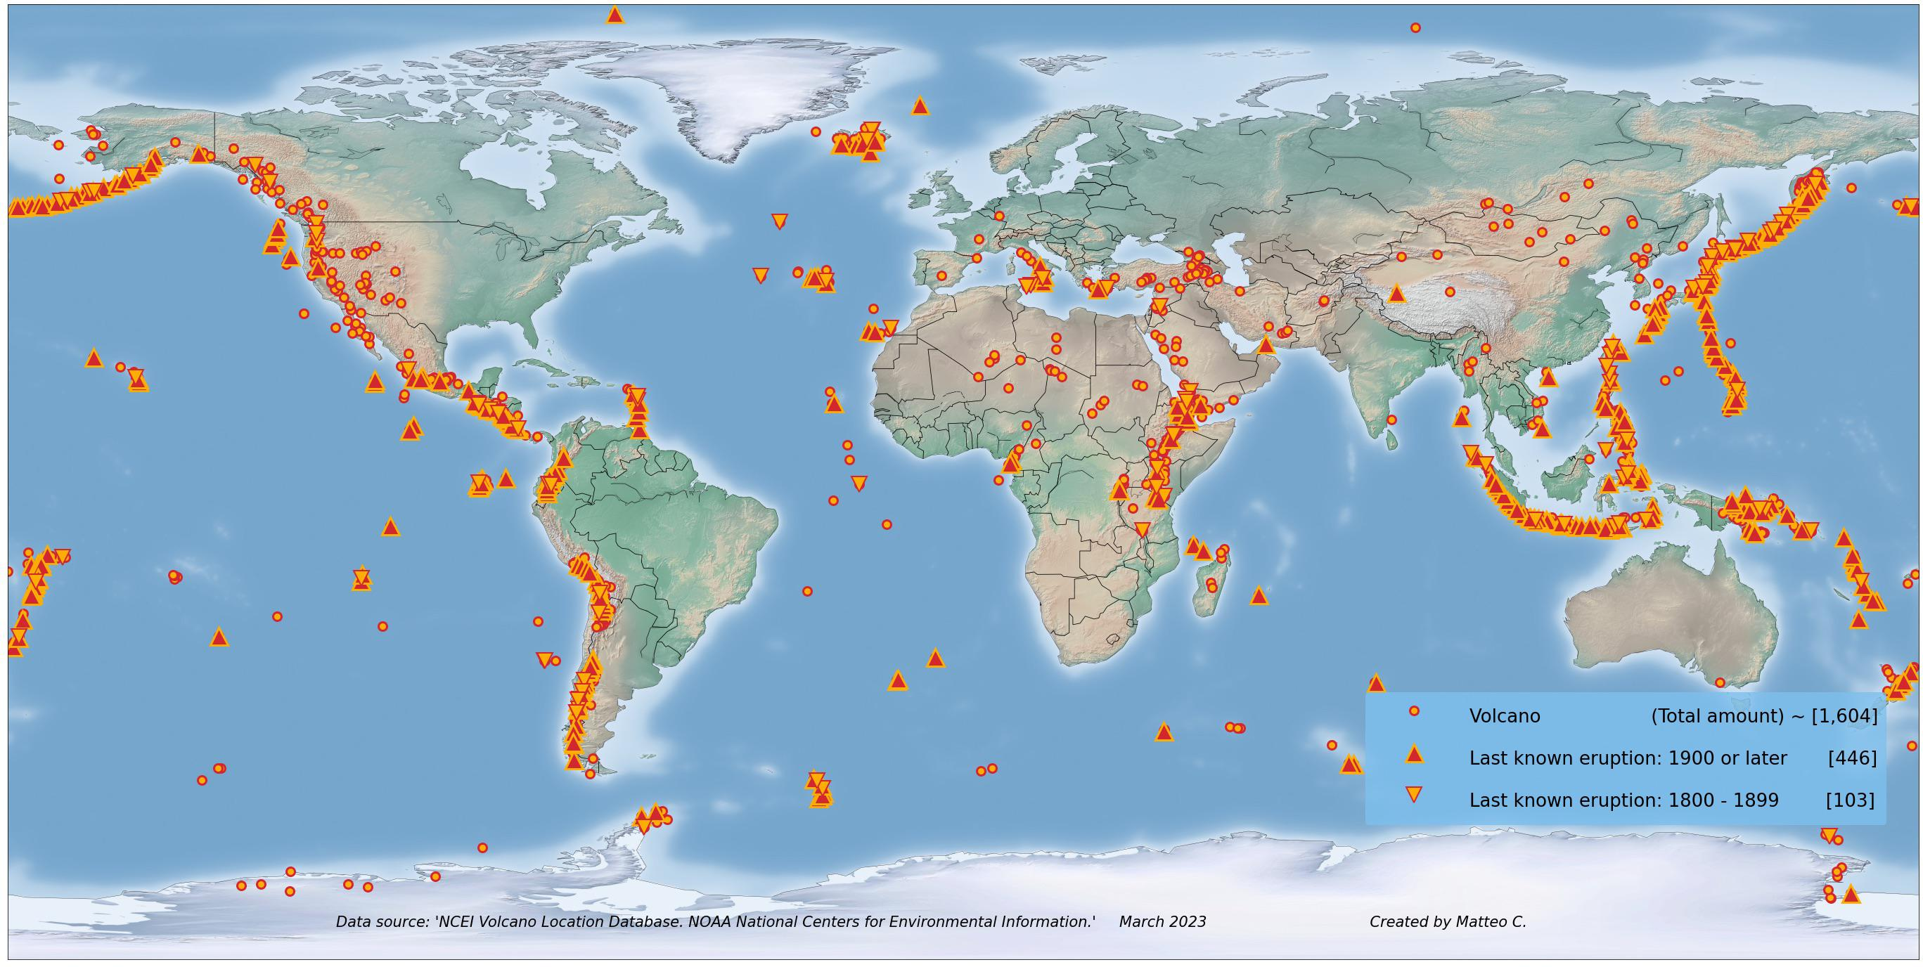
Year 5 – Autumn / Spring – What is a natural disaster? – Geography – Knowledge Organiser
Key Vocabulary
Natural disaster | A natural event that causes great damage or loss of life
Tectonic plates | Massive, irregularly shaped slabs of solid rock (made up of the earth’s crust and upper mantle) that the earth’s surface sits upon
Mantle | The region of the earth’s interior between the crust and the core, believed to consist of hot, dense rocks
Crust | The outermost layer of rock of which a planet consists
Volcano | A mountain or hill, typically conical, having a crater or vent through which lava, hot vapour and gas are or have been erupted from the earth’s crust
Earthquake | A sudden violent shaking of the ground, typically causing great destruction, as a result of movements within the earth’s crust or volcanic eruption
Tsunami | A long, high sea wave caused by an earthquake or other disturbance
Effusive [eruption] | An eruption dominated by an outpouring of lava onto the ground
Explosive [eruption] | An energetic eruption that produces mainly ash, pumice and fragmental ballistic debris
Epicenter | The point on the earth’s surface vertically above the focus of an earthquake
The Lithosphere is made up of the Earth’s Crust and the upper most part of the Mantle beneath.
The Crust is the earth we can see and know – this is anywhere from 0 to 100km deep.
The Mantle is a huge layer of liquid rock between the Crust and the Core. Depending on how close it is to the Core, it is more or less liquid.
Tectonic plates are massive chunks of solid mantle and crust that float on top of the liquid Mantle beneath. They are what we call the Lithosphere.
These two overlayed maps show the location of notable earthquakes and volcanic eruptions in the past ~100 years.
They overlap in their locations because both natural events are caused by the movements of tectonic plates at their boundaries.

