Slide 1
The Parents’ Guide
Version 1

Slide 2
2
What is Wonde?
Wonde is our new online platform that we use to link most of the resources the schools uses under a single account. This means children no longer have to remember multiple passwords and websites to access a majority of the school resources.
Below are some examples of school resources that can be accessed through Wonde.
Your child has been provided with a Magic Badge and Emoji Password to log into Wonde.
If you don’t have either please speak to your class teacher who will be able to print one off.

Slide 3
3
Accessing Wonde
To access Wonde you will need to go through the portal that is specific to St Mary’s Fields. Below is a link to the portal and also a QR code that can be scanned by your devices camera. We would recommend bookmarking the school portal for future use.
If you using a school owned device there will be a shortcut to Wonde already.
https://edu.wonde.com/login/StMarysFieldsPS
OR

Slide 4
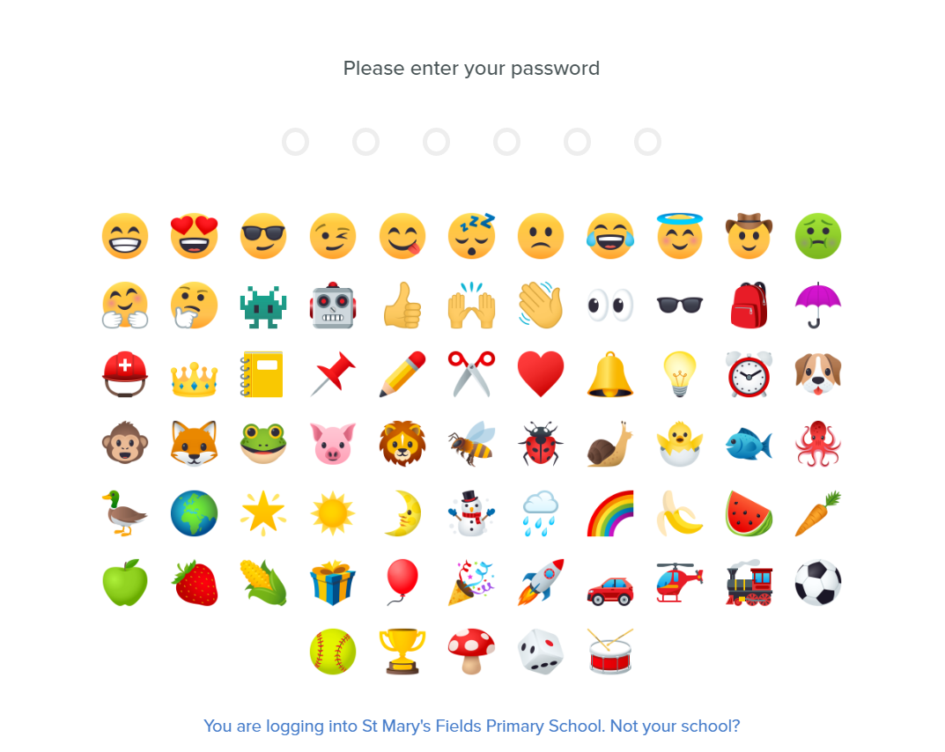
4
Logging in with an Emoji Password
1) Click Login with Emoji Password on the right side of the screen on the Wonde login page.
2) Enter the Emoji Password that was provided.

Slide 5
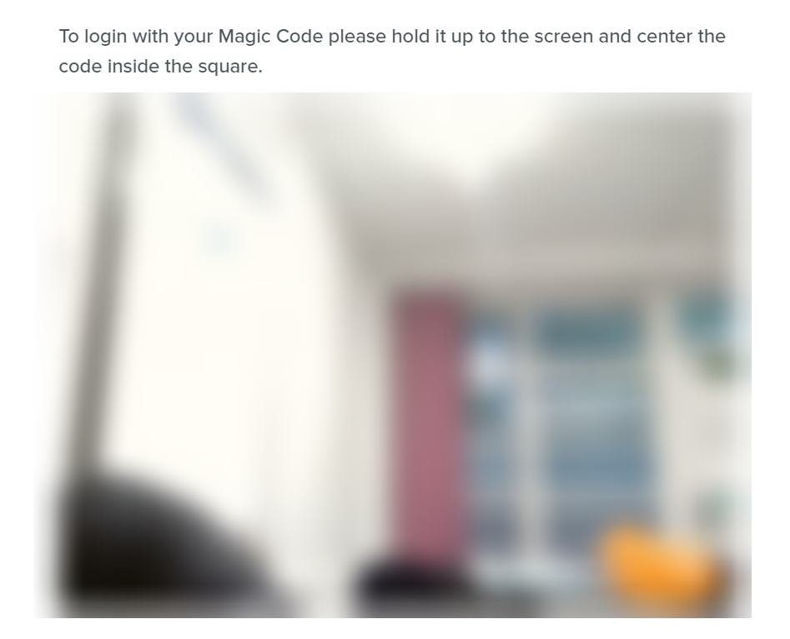
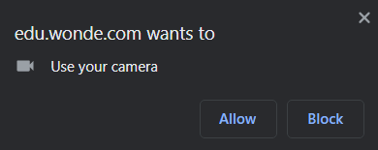
5
Logging in with a Magic Badge
1) Click Login with Magic Badge on the right side of the screen on the Wonde login page.
2) Scan the provided Magic Badge in front of your devices camera.
You may get a prompt to give permission for Wonde to use your devices camera, if this appears click allow.

Slide 6
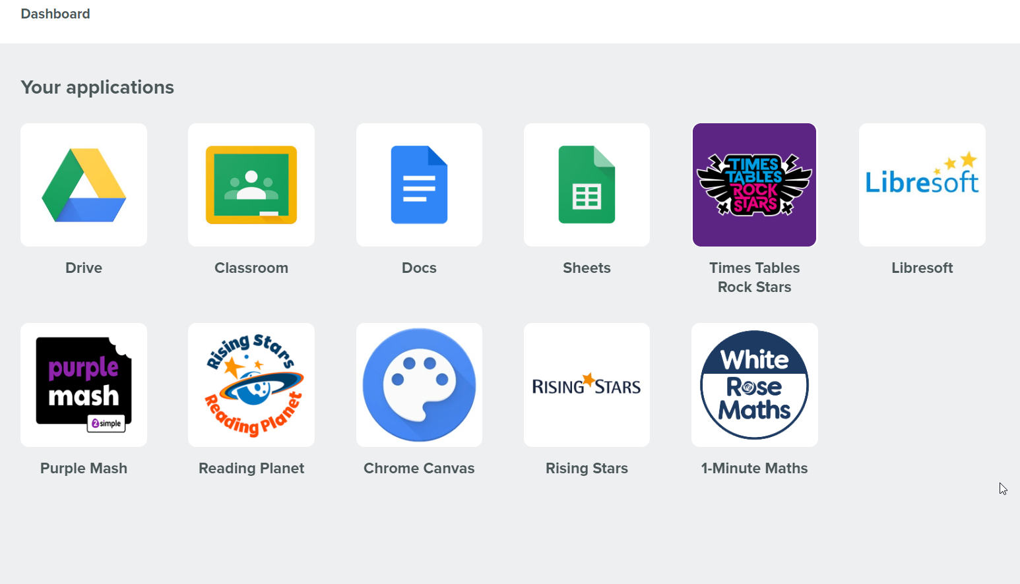
6
After logging in you should see the dashboard where shortcuts to all the school resources are.

Slide 7
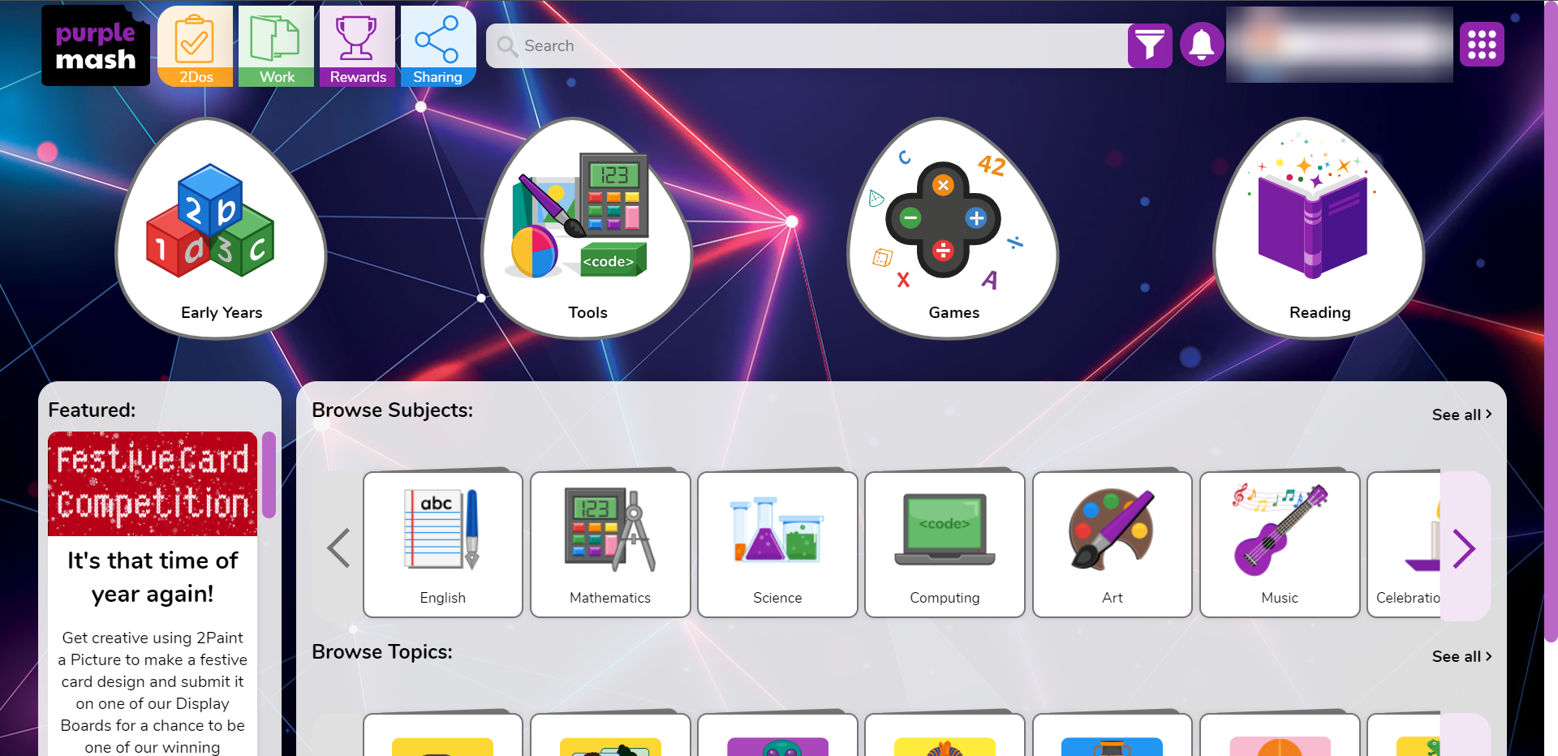
7
Clicking onto a shortcut will automatically log you in and take you to the program.

Slide 8
8
Questions or Issues?
If you have any questions or run into any issue using Wonde, please get in contact with the class teacher or send an email to:
Wonde@st-marysfields.leicester.sch.uk

